Slide 1

System Desing
Introduction to System Design

Slide 2


Ashish Rautela
Experienced professional with a strong proficiency in various technology domains. I have successfully executed multiple projects for Fortune 500 clients and have collaborated with a company accredited at CMM Level 5. My primary focus area is to assist my clients in achieving digital transformation within their business operations.
Vivek Srivastava
Experienced professional with a comprehensive skill set that encompasses various technologies. I possess deep expertise, visionary thinking, and a notable portfolio of innovative projects. My focus is on assisting businesses in achieving their objectives by leveraging technology and domain knowledge.

Slide 3
Agenda
Introduction to System & System Design
Key Characteristics
Key Elements
Key Concepts of System Design
System Design Phases
Requirement Analysis
System Architecture
Detailed Design
Implementation
Testing
Deployment and Maintenance

Slide 4
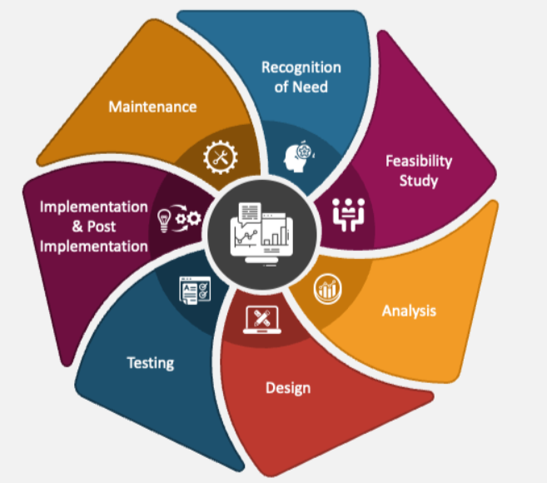
Introduction to System & System Design
The term "system" typically refers to the complex and interconnected set of components, software, hardware, processes, and resources that work together to achieve a specific set of goals or functions.
A system is designed to address a particular problem or fulfill specific requirements.
System design is a process of creating or refining a system to meet specific requirements.
It involves defining system architecture, selecting appropriate components, designing interfaces, and ensuring the system operates efficiently and effectively.

Slide 5
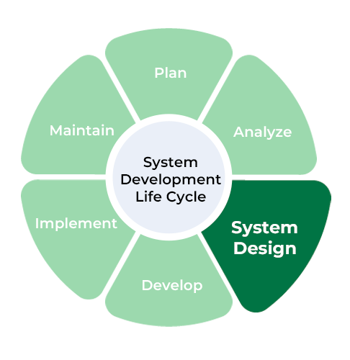
Key Characteristics
Interconnected Components
Purpose
Boundaries
Interactions
Hierarchy / Functional Decomposition
Functional & Non-Functional Components
Usability
Optimization
Security
Notes:
subsystems or components

Slide 6
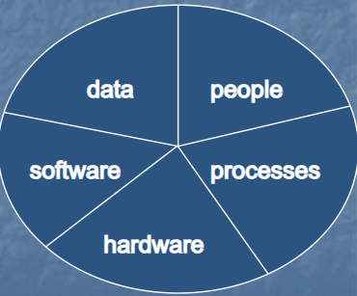
Key Elements
People
Processes
Hardware
Software
Data
Notes:
subsystems or components

Slide 7
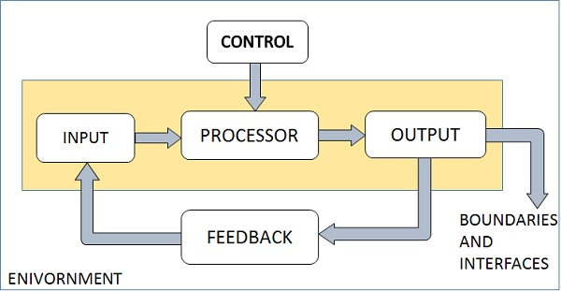
Key Concepts of System Design
OOPs
Scalability
Interoperability
Redundancy and Fault Tolerance
State Management
Design Patterns
Feedback Loop
Notes:
Public, private, internal, protected, data member, static, properties, overloading, method, shared data members(static)

Slide 8
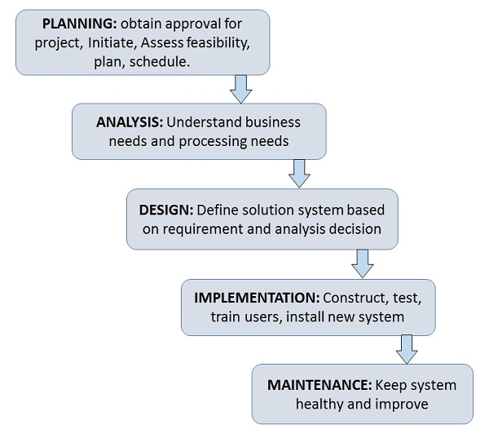
System Design Phases
Requirements Analysis
System Architecture
Detailed Design
Coding
Testing
Deployment and Maintenance

Slide 9
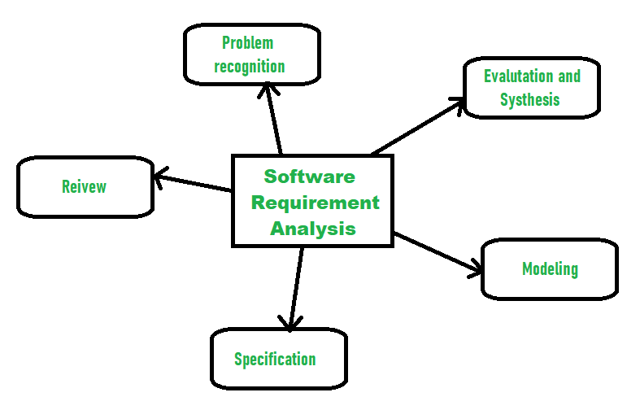
Requirement Analysis
Identify Stakeholders
Requirement Elicitation
SRS Document
Functional Requirement
User Stories
Use Cases
Diagram
Non-Functional Requirement
Capacity Planning
Performance Criteria
Devices & Hardware
Validation and Verification
Traceability
Prototyping and Mockups
Communication and Collaboration
Iterative Process
Tools and Software

Slide 10
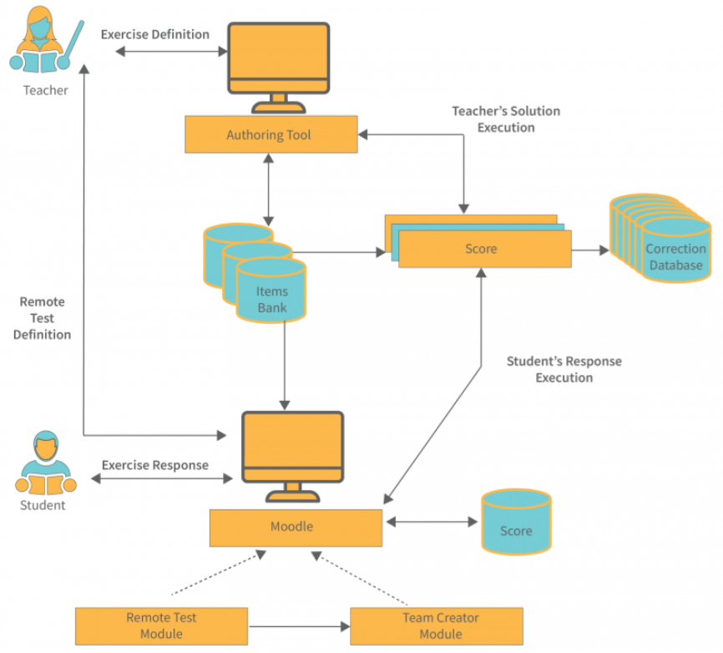
System Architecture
Components
Relationships
Abstraction
Scalability
Modularity
Layering
Patterns and Styles
Performance Considerations
Security
Technologies and Standards
Documentation

Slide 11
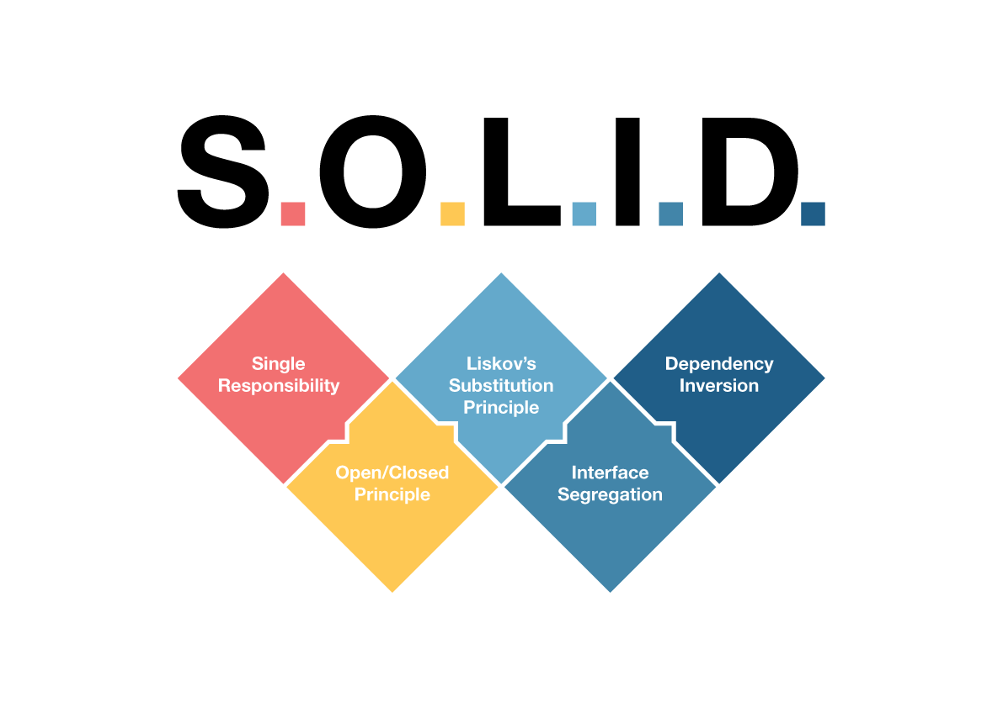
SOLID Principles
Single Responsibility Principle (SRP)
Open/Closed Principle (OCP)
Liskov Substitution Principle (LSP)
Interface Segregation Principle (ISP)
Dependency Inversion Principle (DIP)

Slide 12
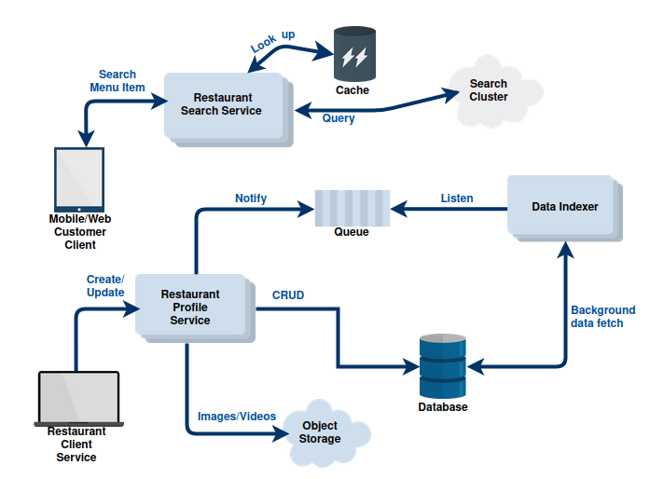
Detailed Design
The design phase in the system development life cycle is a critical step where the detailed design of the system is created based on the requirements and high-level architecture established in earlier phases.
Detailed System Architecture
Component and Module Design
Database Design
Algorithm and Logic Design
User Interface Design
Security Design
External System Integration
Performance Considerations
Performance and Scalability Design
Documentation
Prototyping

Slide 13
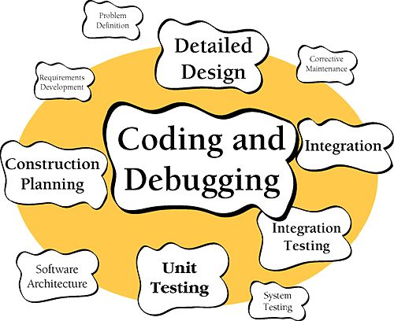
Coding
The coding phase, also known as the programming phase, is a critical stage where the actual source code for the software is developed.
Coding
Programming Language
Modularization
Coding Standards
Testing and Debugging
Documentation
Code Review
Version Control
Integration
Optimization
Security
Scalability

Slide 14
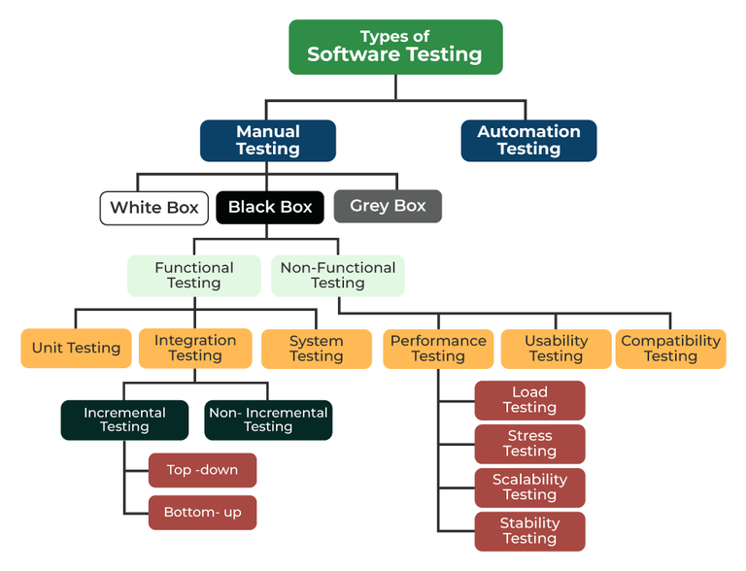
Testing
White box Testing
Black box Testing:
Types
Functional
Non-Functional
Boundary Value Analysis
Equivalence Partitioning
Error Guessing

Slide 15
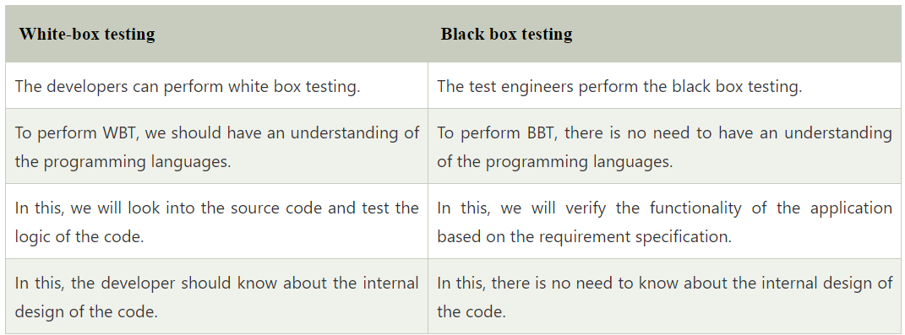
White Box Testing
Control Flow Testing
Branch Testing
Statement Testing
Decision Testing

Slide 16
White Box Testing
Control Flow Testing
Branch Testing
Statement Testing
Decision Testing

Slide 17
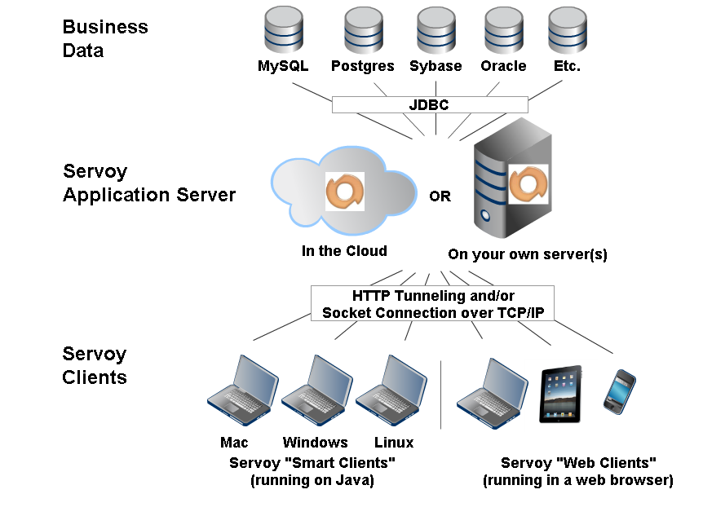
Deployment & Maintenance
Deployment
Installation
Data Migration
Testing
Training
Maintenance
Bug Fixes and Updates
Performance Monitoring
Security Updates
Scalability and Capacity
Backup & DR
User Support

Slide 18
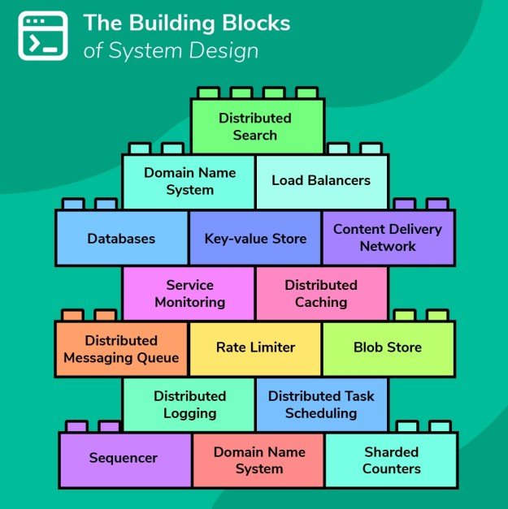
Best Practices in System Design
Design Patterns
Code Reusability
Documentation
Version Control
Collaboration & Communication
Performance Optimization

Slide 19
Conclusion
Recap of System Design
Phases Of System Design
Best Practices

Slide 20
Q&A
Thank You
viveks@avaksh.com
ashish.rautela@avaksh.com

